Slide 1
Earthquake of 1886
Charleston, South Carolina

Slide 2
Earthquake of 1886
An earthquake near Charleston, South Carolina, on this day in 1886 leaves more than 100 people dead and hundreds of buildings destroyed. This was the largest recorded earthquake in the history of the southeastern United States.

Slide 3
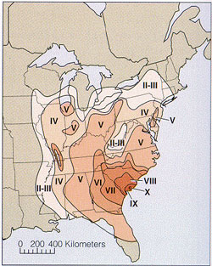
Earthquake of 1886
The earthquake was preceded by foreshocks felt in Summerville, South Carolina, on August 27 and 28 but, still, no one was prepared for the strength of the August 31 quake. At 9:51 p.m., the rumbling began, and it was felt as far away as Boston, Chicago and Cuba. There was damage to buildings as far away as Ohio and Alabama.

Slide 4
Earthquake of 1886
Charleston, South Carolina, though, that took the biggest hit from the quake, which is thought to have had a magnitude of about 7.6. Almost all of the buildings in town were seriously damaged. It is estimated that 14,000 chimneys fell from the earthquake. It caused multiple fires and water lines and wells were ruptured. The total damage was in excess of $5.5 million (about $112 million in today’s money).

Slide 5
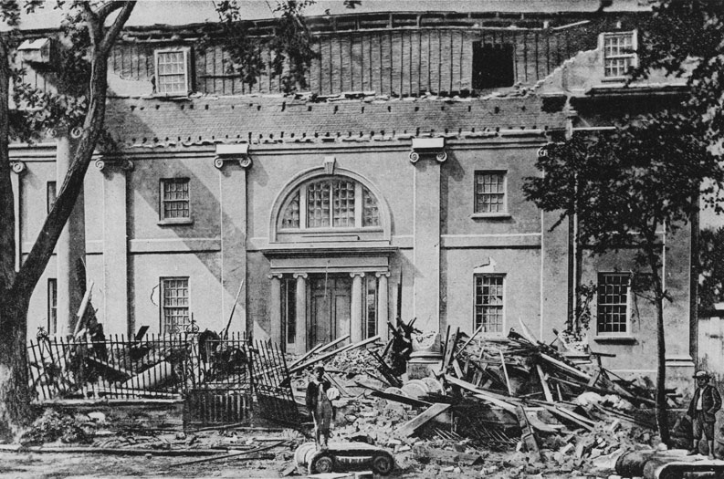

Slide 6
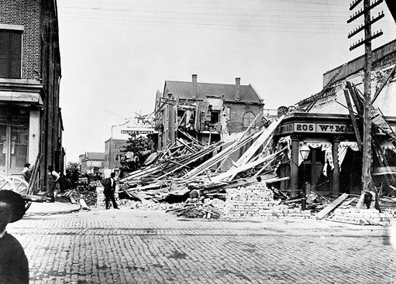

Slide 7
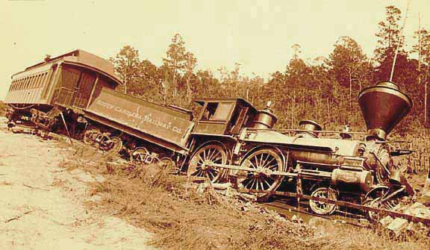

Slide 8
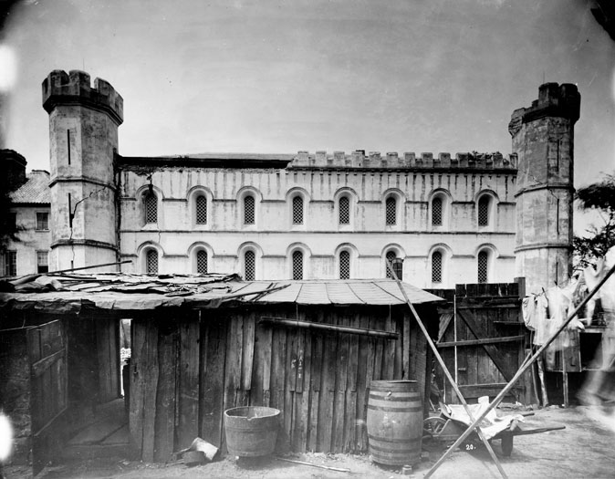

Slide 9
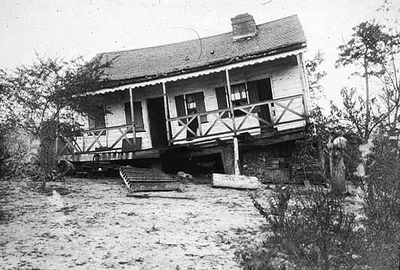

Slide 10
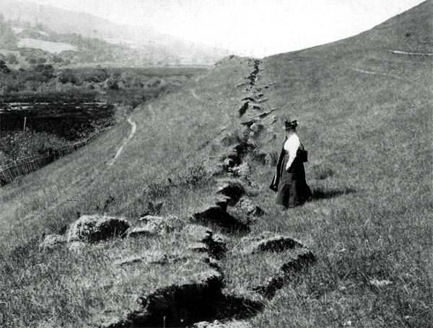

Slide 11
Earthquake of 1886: Two Sources
San Francisco Chronicle, 1906
Written by Paul Pinckney who was trying to reassure San Franciscans that they could recover from their own earthquake
Interview with Two Historians
In their new book Upheaval in Charleston: Earthquake and Murder on the Eve of Jim Crow, Susan Millar Williams and Stephen G. Hoffius explore the aftermath of the destruction and its unhappy effects on relations between the races.

Slide 12
CNN Video on the Earthquake

Slide 13
Tandem Storytelling
You will write a short story taking place in Charleston in 1886, during the earthquake.
For five minutes you will silently write the introduction to your story. Be sure to set the scene.
Then you will switch papers and read the intro. You will then have 5 minutes to write the rising action part of the story.
Switch again, reread the story and add the climax of the story. Switch to add the falling action. Switch one last time to add the conclusion.

