Slide 1
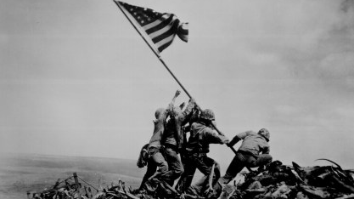
Pacific Theatre
&
Close of the War
7-4.5

Slide 2
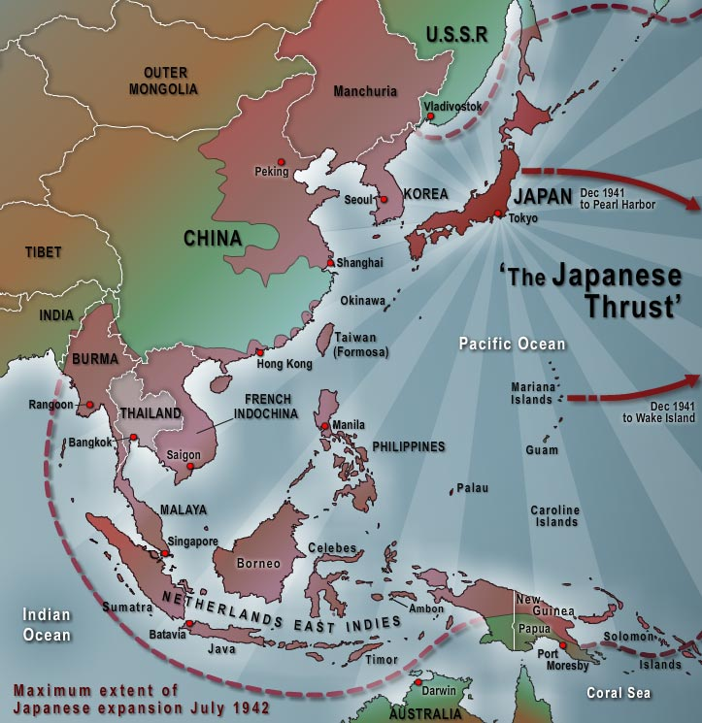
Early Japanese Victories
Japan moved quickly in the Pacific, taking over Guam, Wake Island, Hong Kong, the Philippines, the Dutch East Indies, and Burma. The tide then turned to the U.S. in 1942.

Slide 3
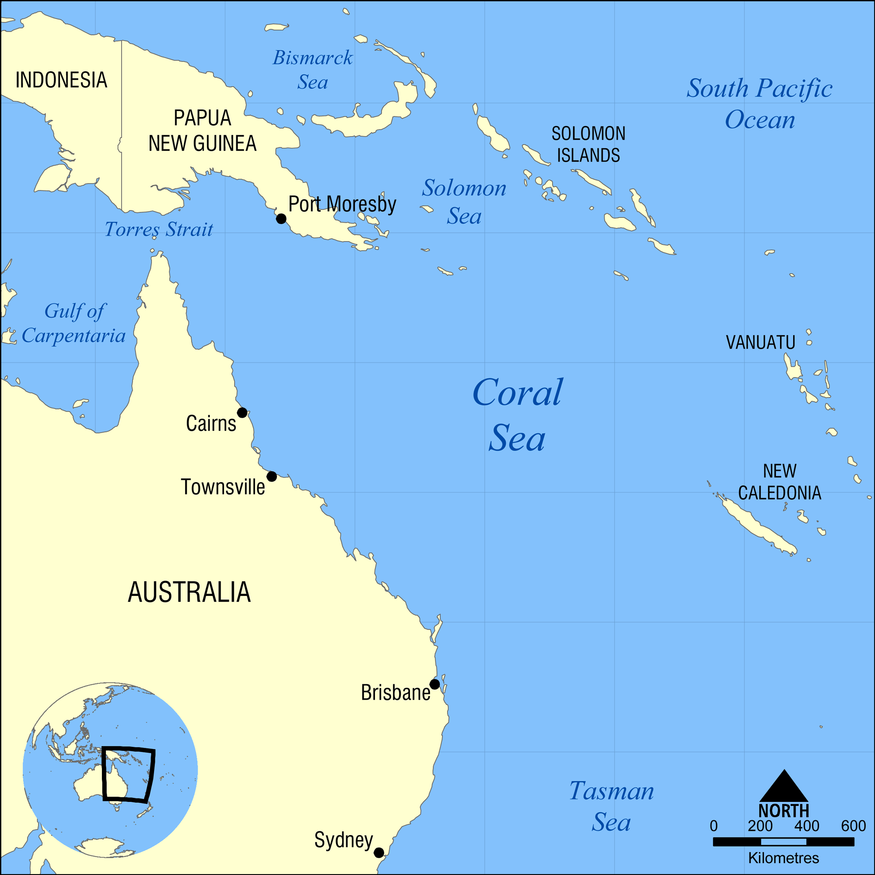
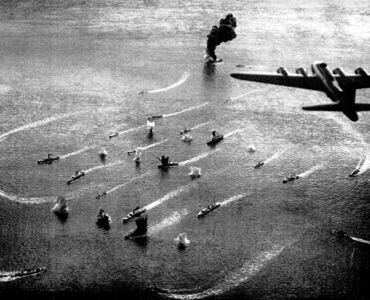
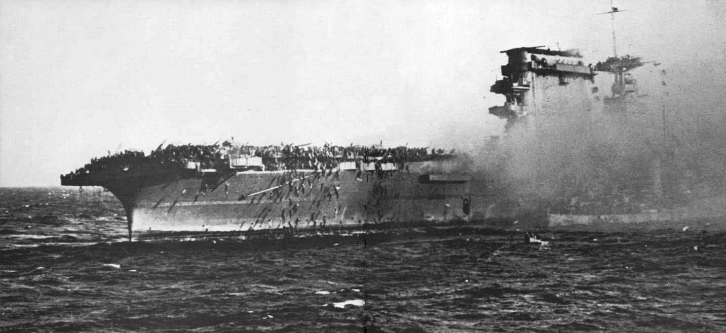
U.S. Victories
The US defeated Japan in the Battle of Coral Sea, which saved Australia from Japanese invasion. Next, the US defeated Japan in the Battle of Midway. They heavily damaged hundreds of Japanese planes and all the aircraft carriers on the island.

Slide 4
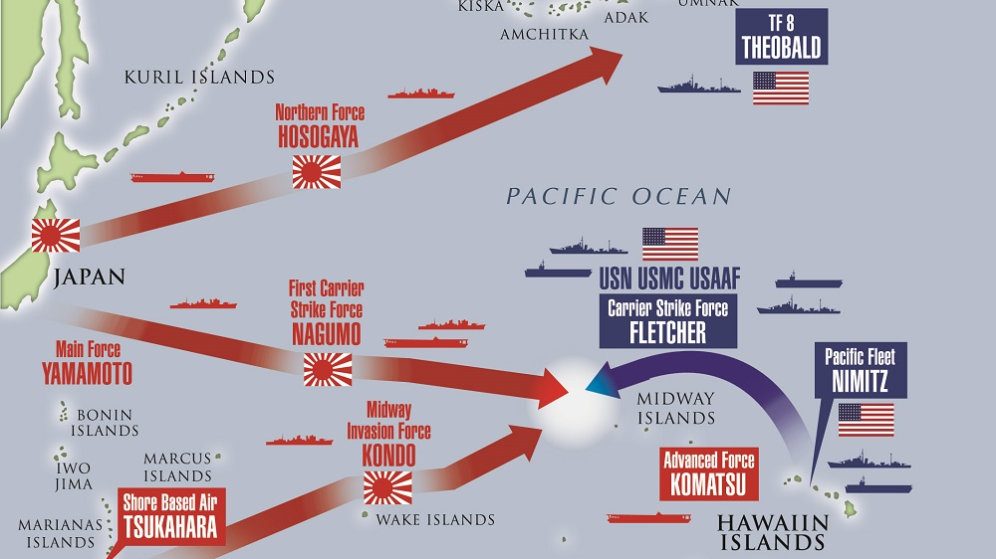
Battle of
Midway

Slide 5
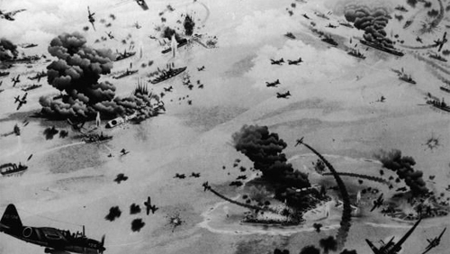
Battle of
Midway

Slide 6
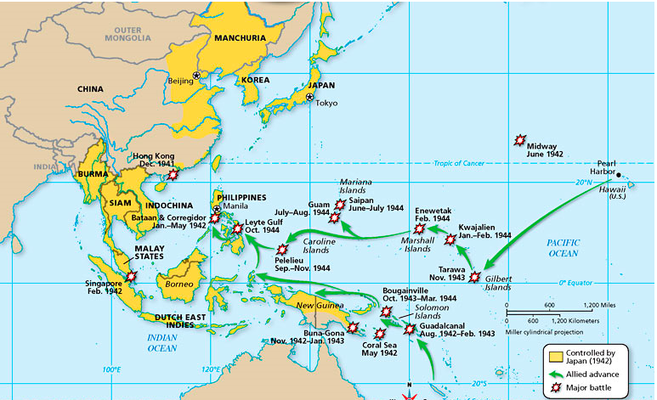
Island Hopping
After the victory at Midway, the US began an “island-hopping” (or leapfrogging) strategy. They bypassed island heavily secured by Japan in favor of taking islands that were strategically located in the drive to reach the main islands of Japan. This saved countless American lives.

Slide 7
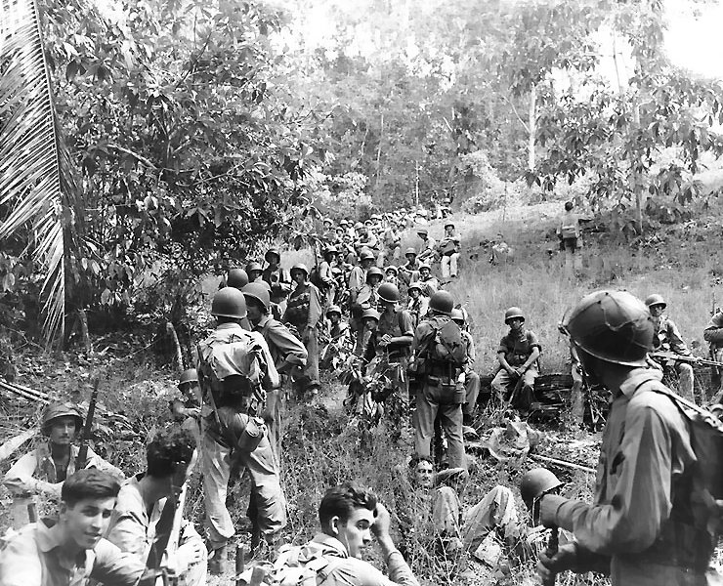
Battle of Guadalcanal
A turning point occurred when the Japanese experienced a devastating loss at the Battle of Guadalcanal. This battle was the first offensive against Japan launched by combined allied forces on land, sea, and air.

Slide 8
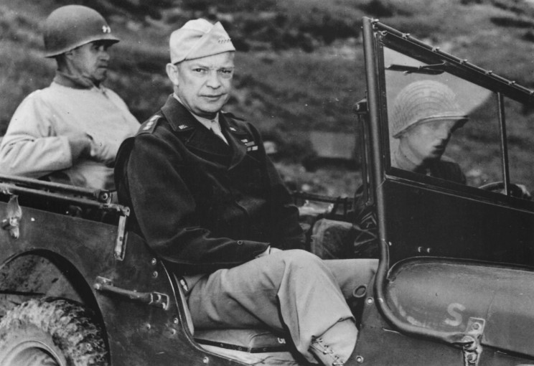
The Tide Changes...
By the end of 1942, the tide had turned to favor the Allies in the Mediterranean and along the Eastern Front. Allied forces, led by General Dwight Eisenhower, defeated German General Rommel’s forces in North Africa.

Slide 9
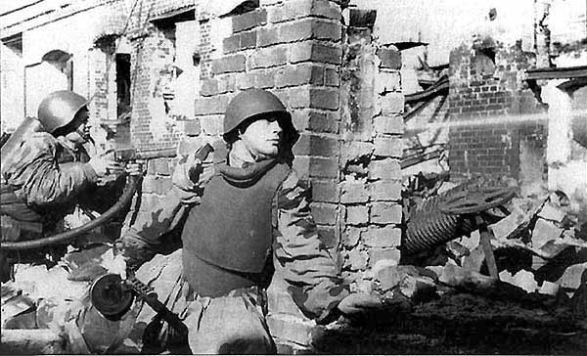
Turning Point in Europe
The Germans then went on the defensive after a turning point victory by the Soviets at the Battle of Stalingrad in February 1943.

Slide 10
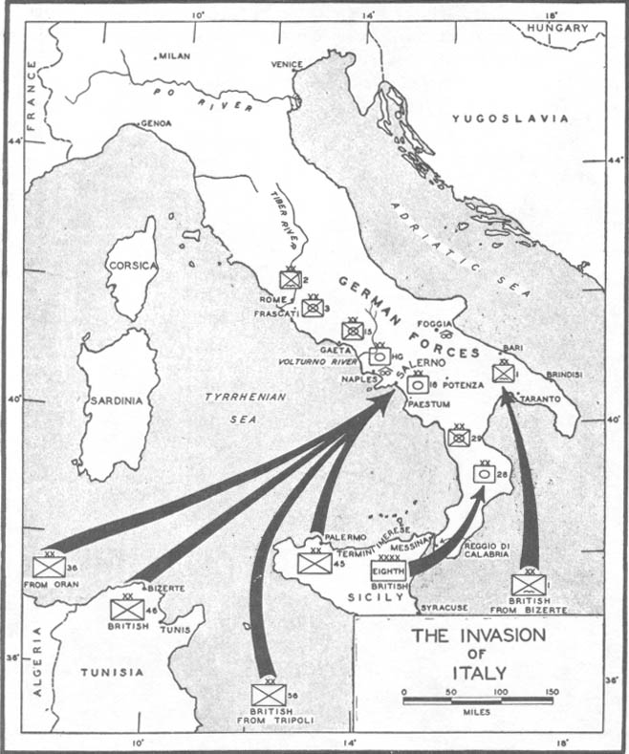
Conquering Italy
As the Soviets pushed the Germans east, the British and American forces invaded and conquered Sicily in 1943. Allied forces entered Rome in 1944 and Mussolini was killed in 1945 by his own countrymen.

Slide 11
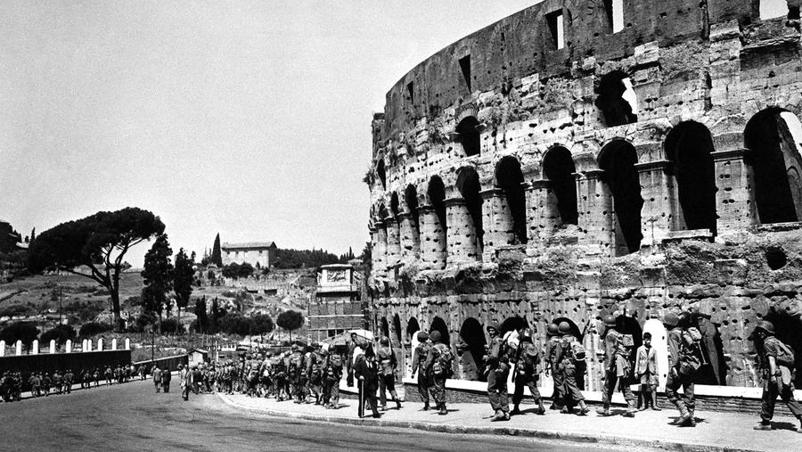
US troops at the Colosseum

Slide 12
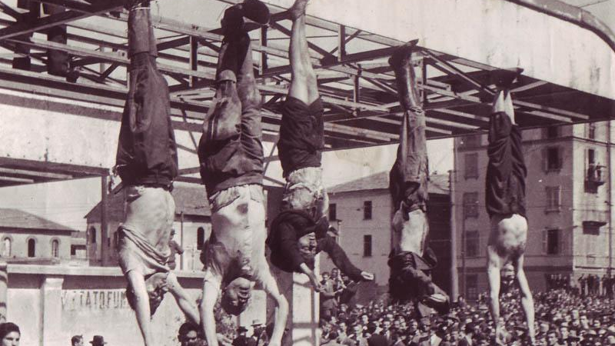
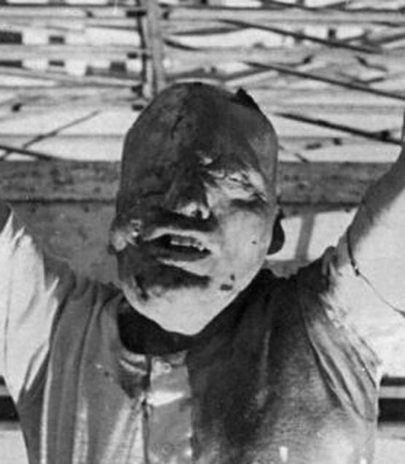
Death of Mussolini

Slide 13
D-Day
The invasion of Normandy, called D-Day, to liberate German-controlled France and northern Europe began on June 6, 1944 and the Allied forces were able to liberate France

Slide 14
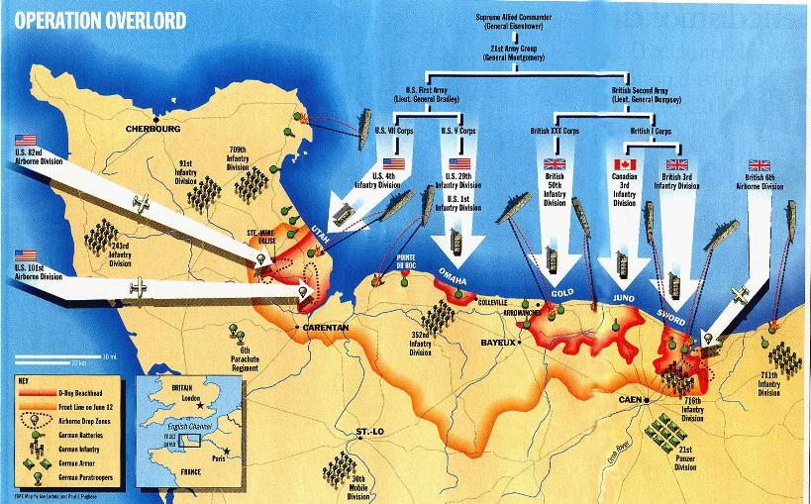
D-Day

Slide 15
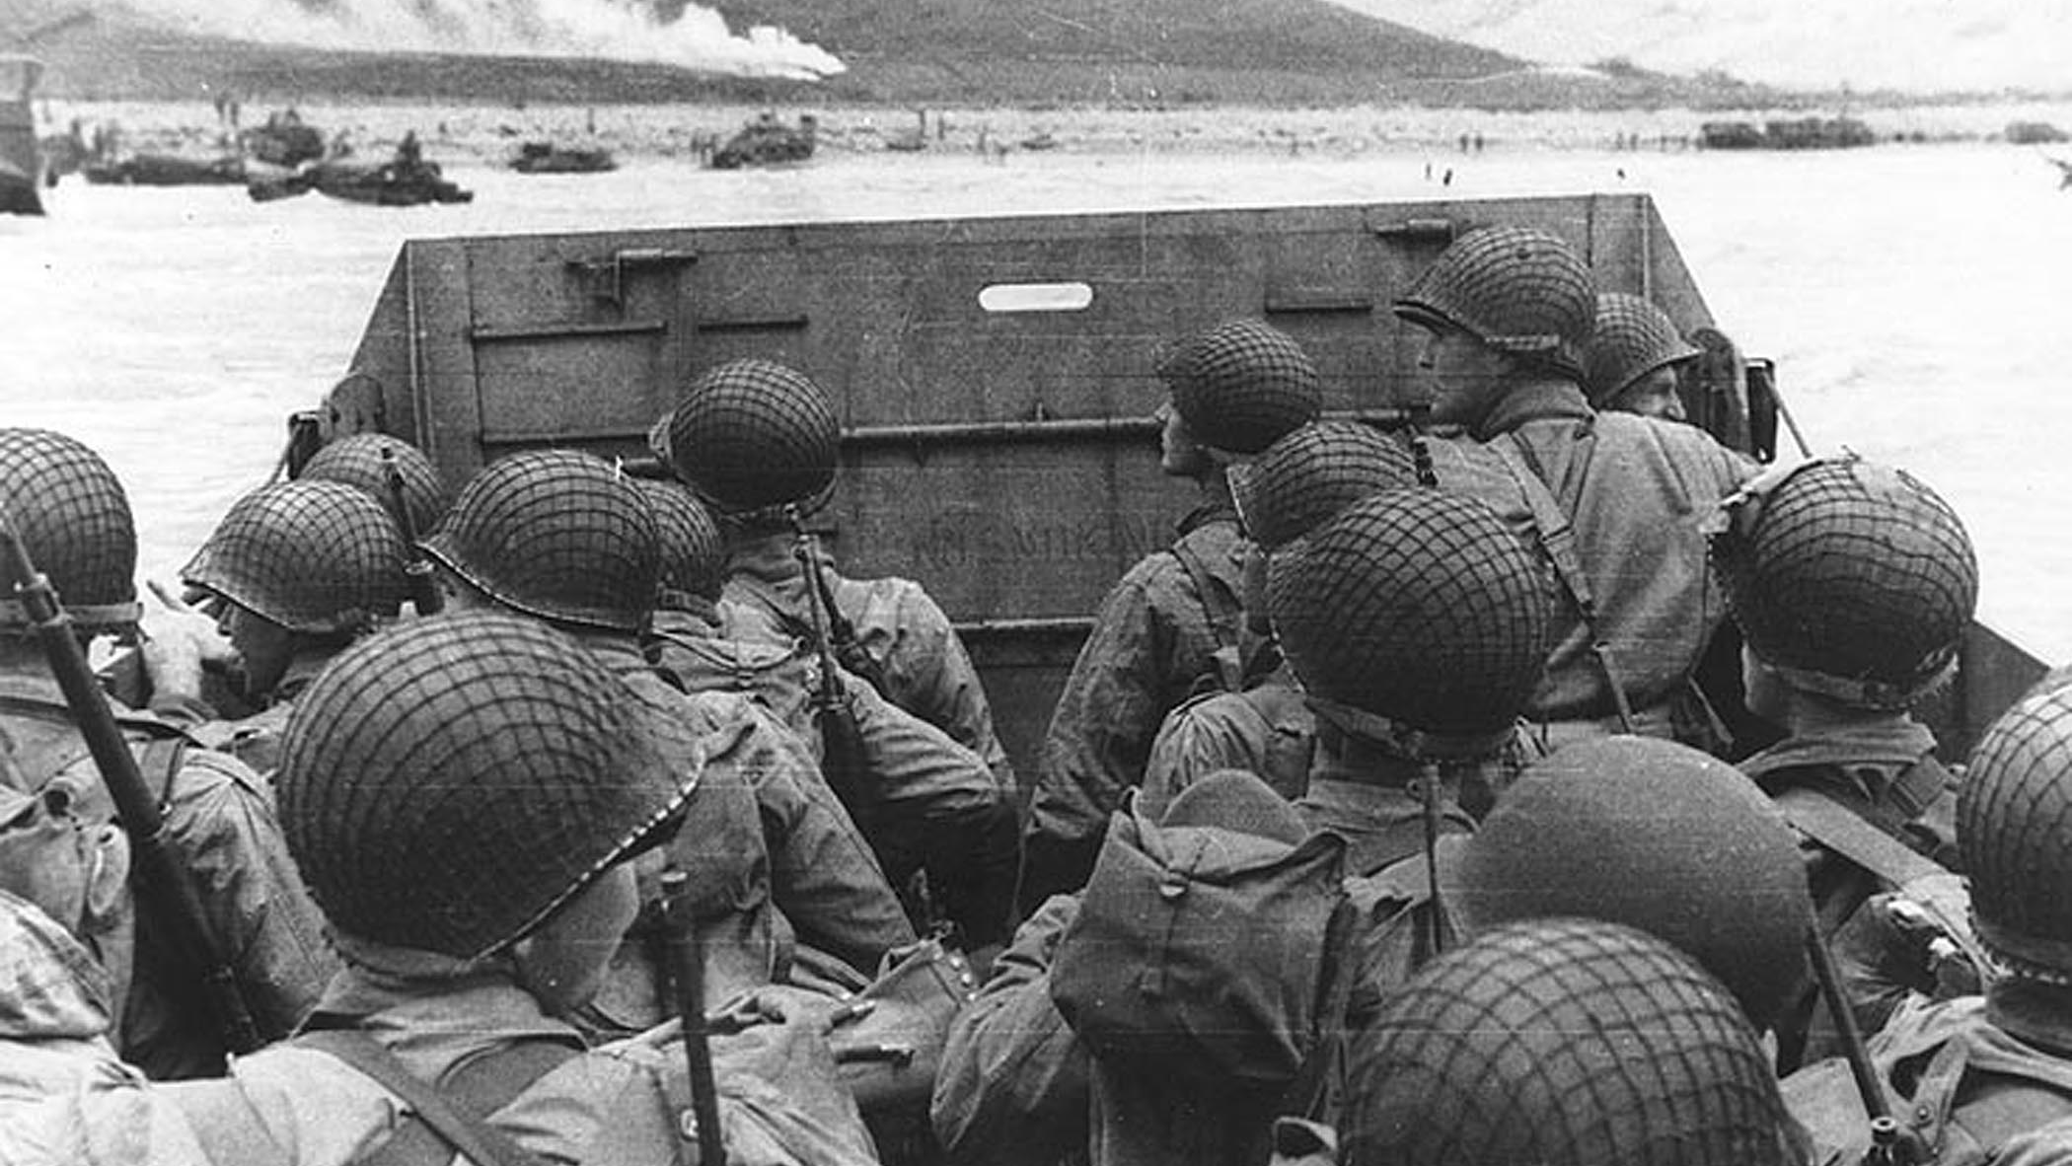
D-Day

Slide 16
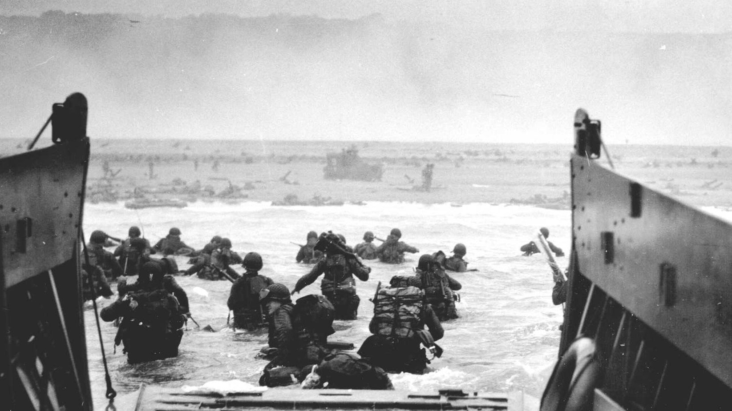
D-Day

Slide 17
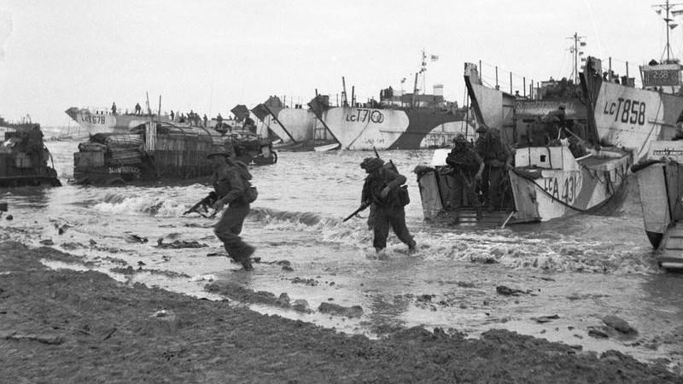
D-Day

Slide 18
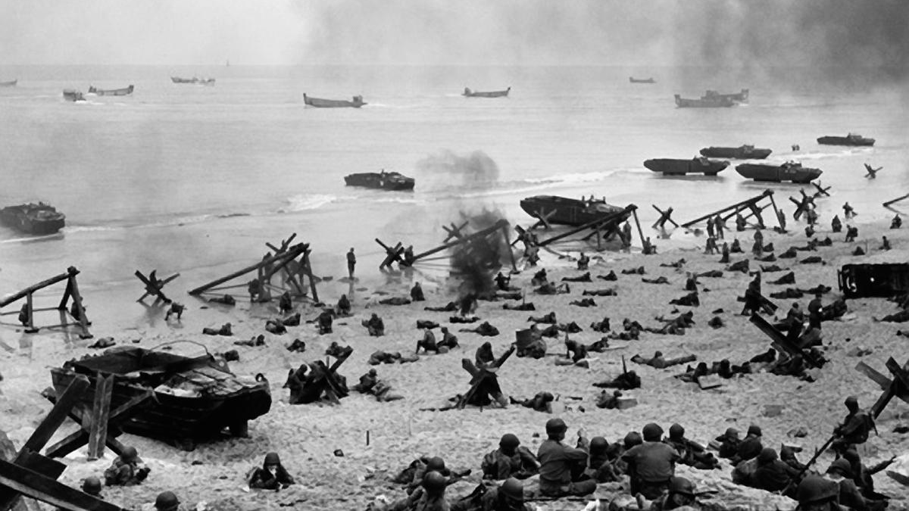
D-Day

Slide 19
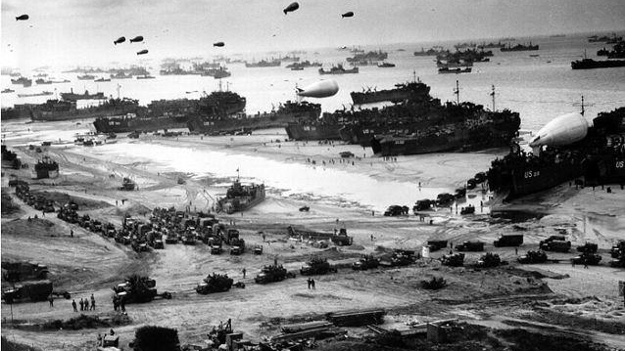
D-Day

Slide 20
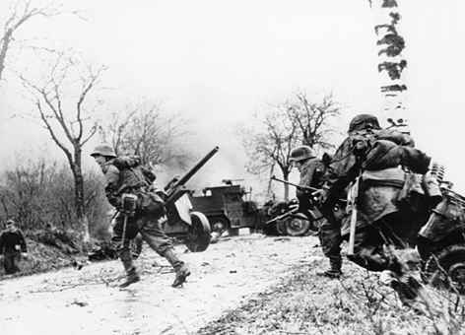
Victory in Europe
Hitler’s final attempt to achieve victory against Allied forces was at the Battle of the Bulge. Despite breaking through American defenses, the Germans were ultimately pushed back and forced to retreat. Allied troops from both east and west moved into Germany, causing the Germans to surrender on May 7, 1945 (VE Day).

Slide 21
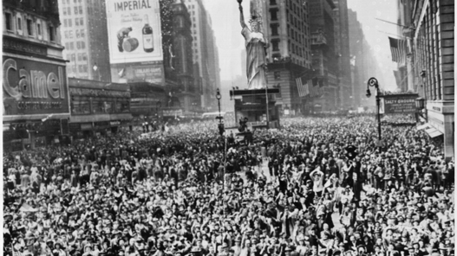
V.E. Day

Slide 22
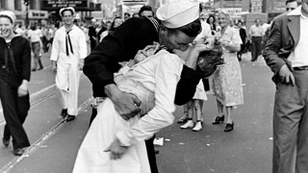
V.E. Day

Slide 23
Victory in the Pacific
The U.S. then moved closer to defeating Japan by victories at Iwo Jima and Okinawa. Citing the need to hasten the war’s end and save lives that would be lost in an invasion of the island country, President Harry Truman ordered the dropping of an atomic bomb on Hiroshima on August 6, 1945 and over Nagasaki three days later. Six days after the dropping of the second atomic bomb, Japan announced its intention to surrender, formally doing so on September 2, 1945 (VJ Day).

Slide 24
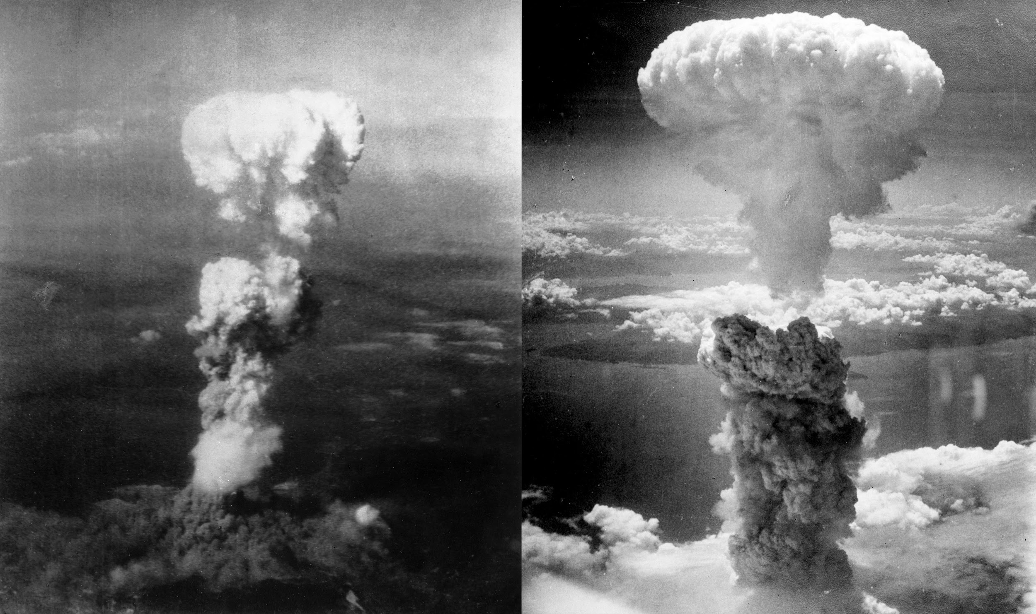
Hiroshima & Nagasaki Clouds

Slide 25
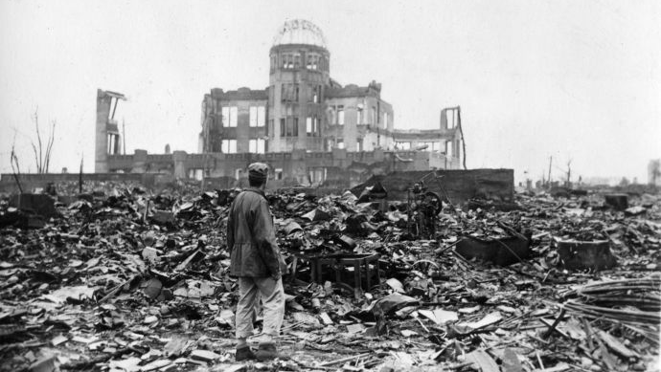
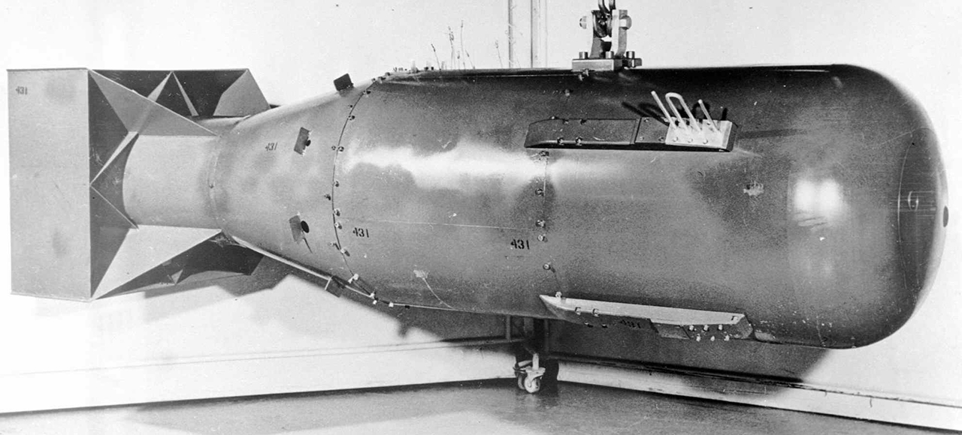
Hiroshima

Slide 26
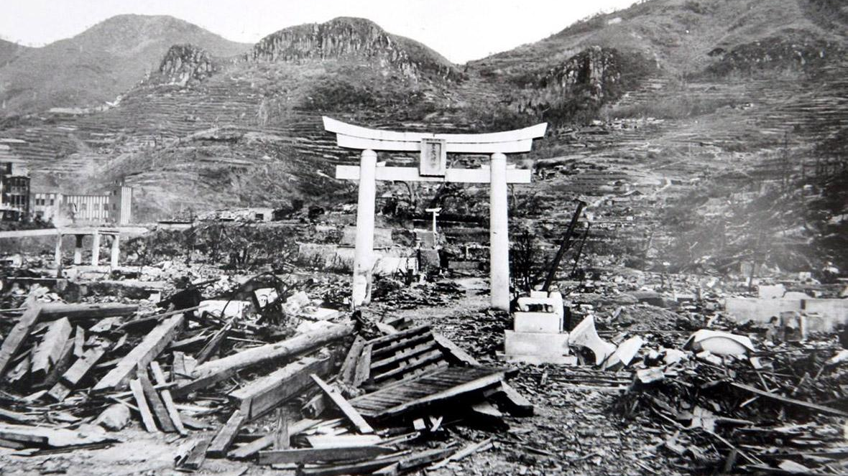
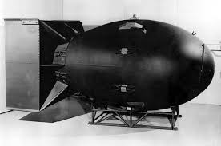
Nagasaki

