Slide 1
7-4.5:
Causes of WWII

Slide 2
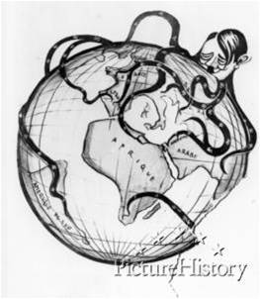
What caused World War II?
World War II was caused by the military aggression displayed by Germany, Italy, and Japan and the discontent caused by the provisions in the Treaty of Versailles. As these countries worked to build empires, little was done by the international community to stop them. Countries were tied up by the Great Depression.

Slide 3
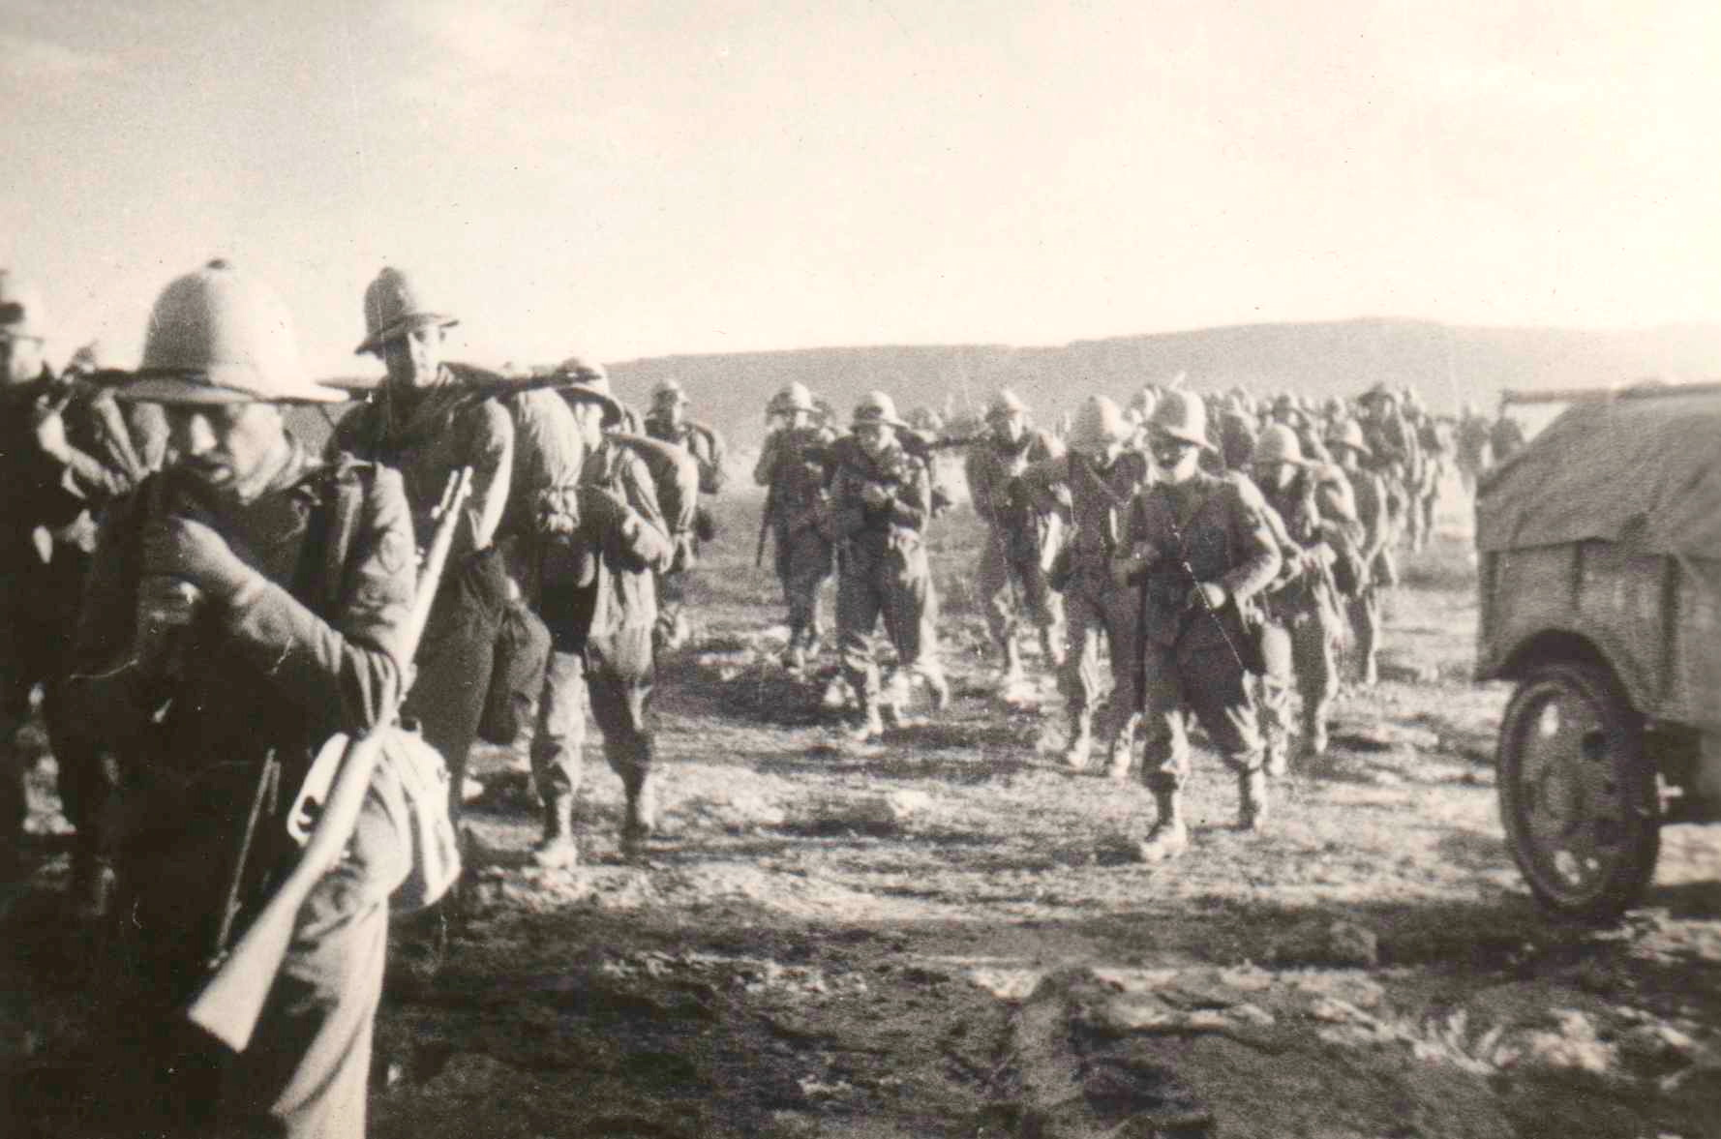
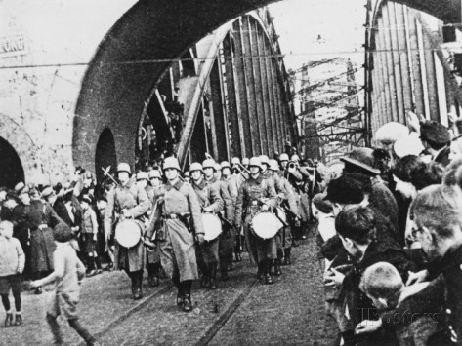
What did the League failed to stop?
Italian troops in Ethiopia
German troops crossing bridge into Rhineland (1936)
The League of Nations failed to stop Italy from invading Ethiopia and Germany from militarizing and occupying the Rhineland.

Slide 4
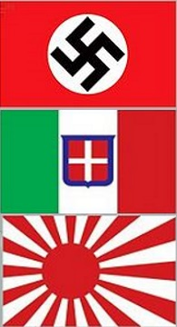
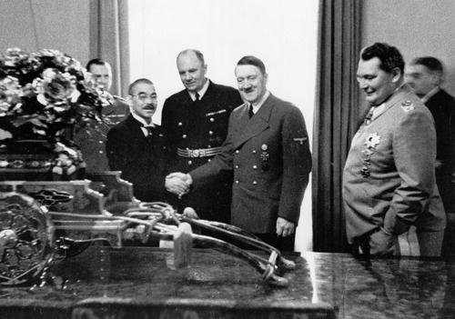
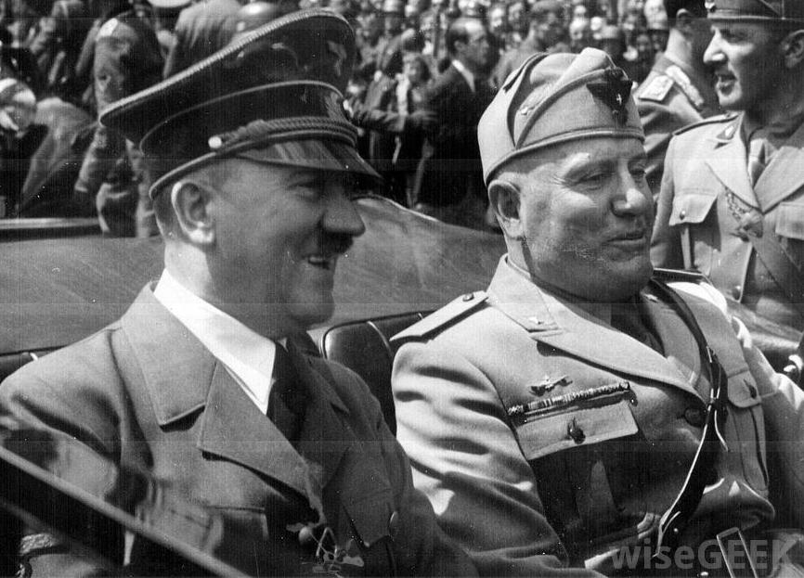
Who formed the Axis Alliance?
In 1936, Italy, Germany, and Japan formed the Axis Alliance. They then sent troops and weapons to Spain to assist Francisco Franco in winning the Spanish Civil War.

Slide 5
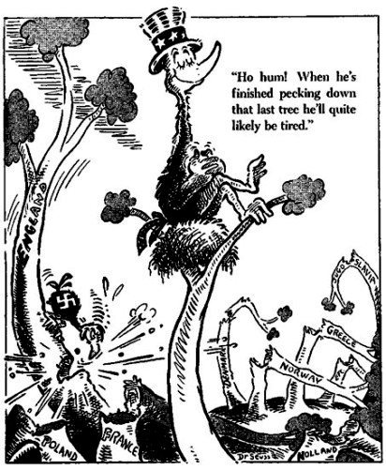
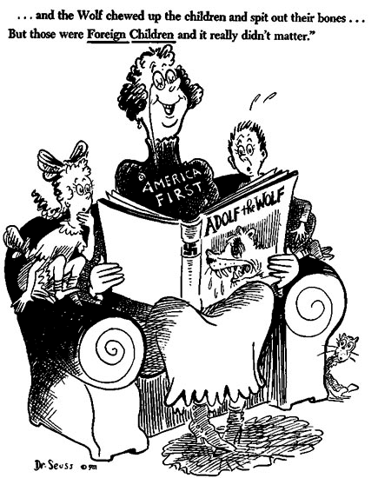
What was the US policy at the start?
The United States chose to remain in isolationism, passing a series of Neutrality Acts that prohibited them from loaning money or selling weapons to countries at war.

Slide 6
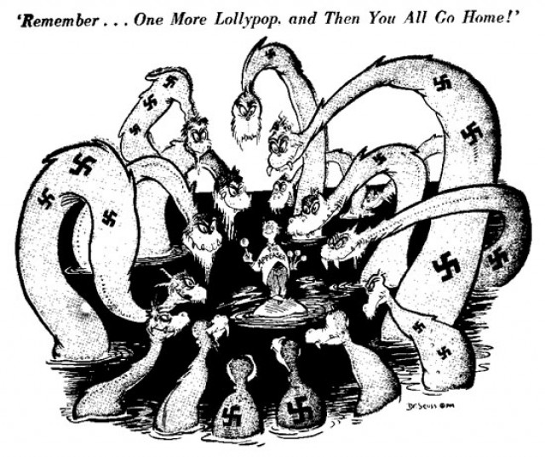
What is appeasement?
Great Britain and France falsely believed that a policy of appeasement (giving into demands) would prevent another war. The Prime Minister of Great Britain Neville Chamberlain argued for this theory. The lack of a firm hand against the aggressive movements of the Axis allowed Hitler to annex Austria in 1938. This is called Anschluss.

Slide 7
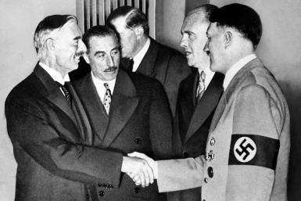
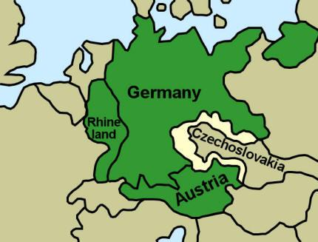
What is the Munich Pact?
Hitler then demanded the Sudetenland (part of Czechoslovakia) during the Munich Conference of 1938. He promised that he would demand no more land after that. France and Great Britain agreed to the Munich Pact.
CHAMBERLAIN (GB)
HITLER

Slide 8
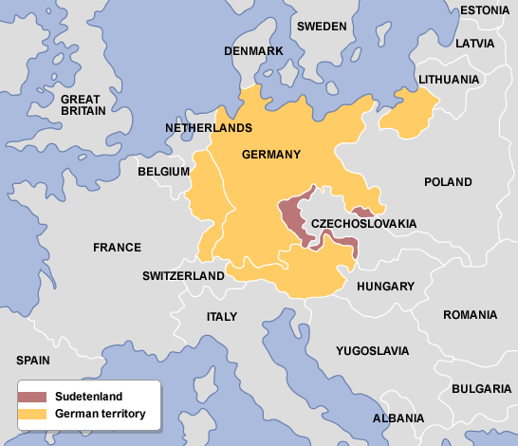
How did appeasement fail?
Appeasement proved to be a failure when Hitler invaded Czechoslovakia in early 1939. Italy then invaded Albania soon after.

Slide 9
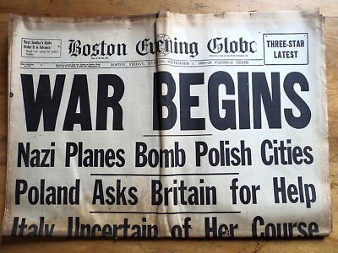
How did war officially begin?
WWII officially began in September 1939 when Hitler invaded Poland. Britain and France came to Poland’s defense and declared war. Japan and China joined the war after Japan invaded in 1937.

