Slide 1
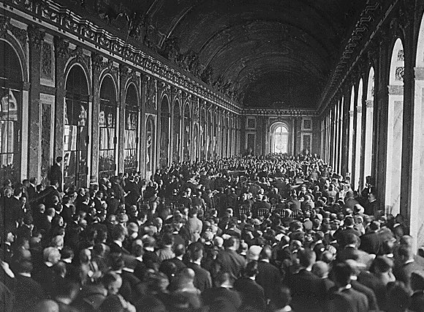
Effects of World War I
Standard 7-4.2: Explain the outcomes of World War I, including the creation of President Woodrow Wilson's Fourteen Points, the Treaty of Versailles, the shifts in national borders, and the League of Nations.
Lesson Set
Skill
Development
Guided
Practice
Closure
Independent
Practice
Assessment
Teacher Notes

Slide 2
Lesson Set
Think about a time when fighting or drama has erupted in your group of friends (whether it included you or not)
How was the drama resolved?
Could you all stay friends or did someone get ousted?
Was it hard to find a solution to the problem?
Home

Slide 3
Versailles

Slide 4
Versailles

Slide 5
Versailles

Slide 6
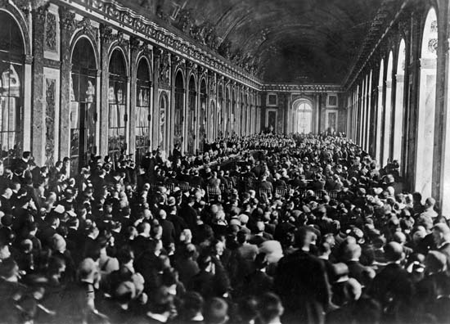
Versailles

Slide 7
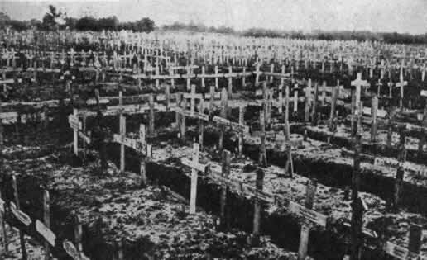
What were the major effects of WWI?
The major effects of WWI were diplomatic solutions (peace talks with world leaders), geographic and political changes, and major economic consequences.

Slide 8
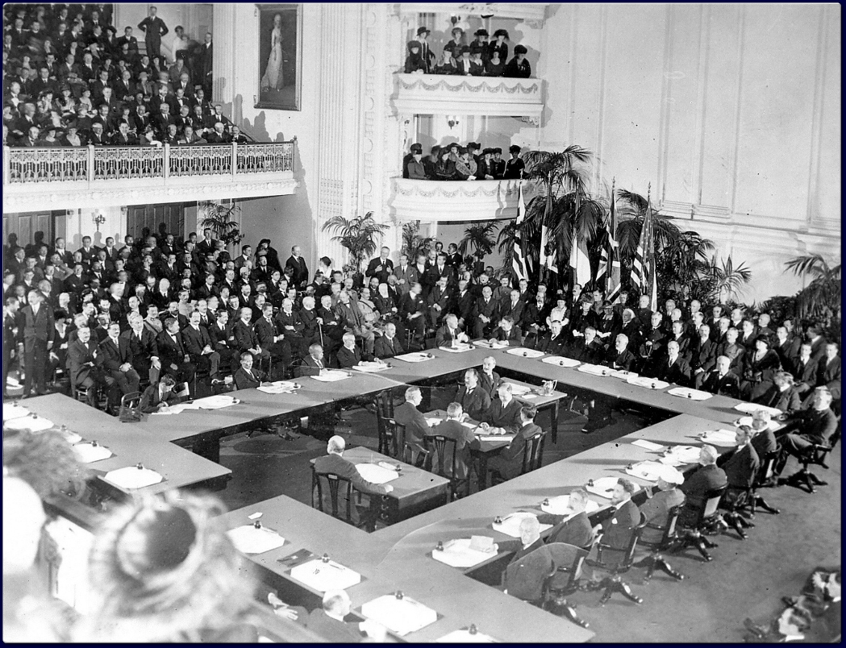
What was the treaty of WWI?
The major peace treaty of World War I was the Treaty of Versailles (named for the Palace where it was signed). Leaders of the countries who contributed to World War I met in a conference to determine the terms of the treaty.

Slide 9
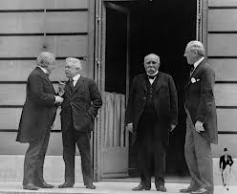
Who were the Big Four?
The talks were led by the Big Four (representatives of the U.S., Great Britain, France, and Italy). Their main focus was to correct the many problems that had led to the Great War and bring about lasting peace.

Slide 10
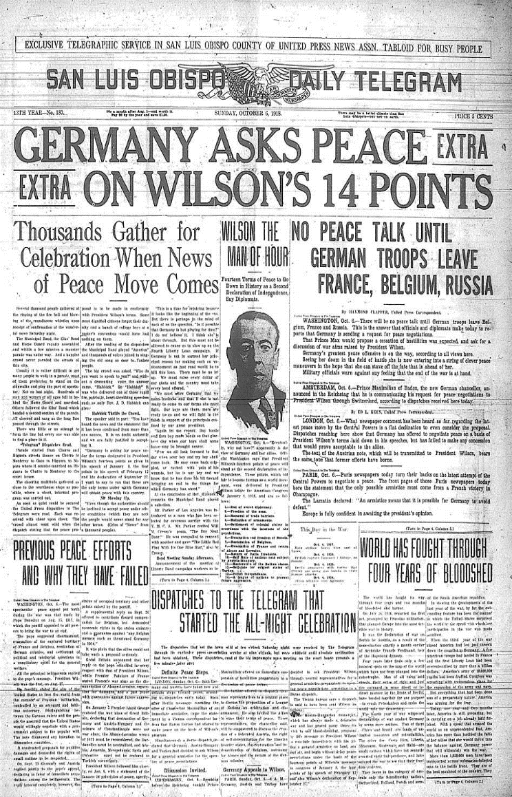
What was Wilson’s plan?
President Wilson wanted the basis of the Treaty to address the causes of the war, and his Fourteen Point proposal contained many ideas directly intended to undo the M.A.I.N causes.
Examples are no military build-up, no secret alliances, and the right to self-determination. Self-Determination is the ability of a group to decide which state they want to be in. This would avoid the resentment Serbia and other nations had towards their imperial leaders.

Slide 11
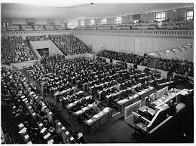
What was the League of Nations?
His fourteenth point included the idea of creating a League of Nations, an international organization designed to resolve disputes between nations and avoid future wars.

Slide 12
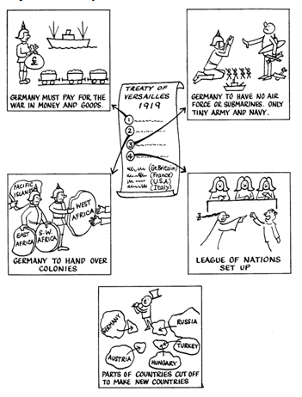
What did the other three want?
Unfortunately the other three of the Big Four rejected most of Wilson’s positive ideas. Instead they wanted to weaken Germany and maintain or enhance their own standing in the world. Their ideas prevailed and the final format of the Treaty of Versailles (1919) was structured to punish Germany.

Slide 13
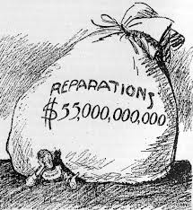
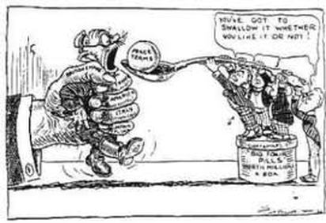
What provisions did the Treaty make for Germany?
The Treaty of Versailles included the “War Guilt Clause” in which Germany was forced to accept responsibility for starting the war.
Further they had to pay reparations, and accept military restrictions like limiting their army to 100,000 soldiers with no air force or submarines.
They also had to demilitarize the Rhineland and lost territories (both internally such as Alsace-Lorraine and all overseas possessions).

Slide 14
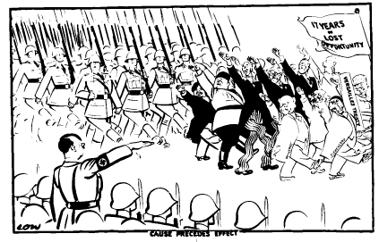
What was the outcome of the Treaty?
This emphasis on the punishment of Germany led to a foundation that would contribute to their economic and political instability to come.
That instability would eventually contribute to the outbreak of WW2.
Furthermore, Russia and other nations were denied a seat at Versailles and this lack of cohesiveness contributed to the inability of the Treaty to provide stability and prevent future wars.

Slide 15
Independent Practice
Activity:
Imagine you are a reporter during the end of World War I. Create a newspaper article announcing the signing of the Treaty of Versailles.
You should include:
A description of the 14 Point Plan
The decisions made at the Treaty of Versailles
The differences between what was ultimately decided at
the Treaty of Versailles and Woodrow Wilson's ideas
included within the 14 Point Plan
A visual representation of the event
The impact of the Treaty of Versailles

Slide 16
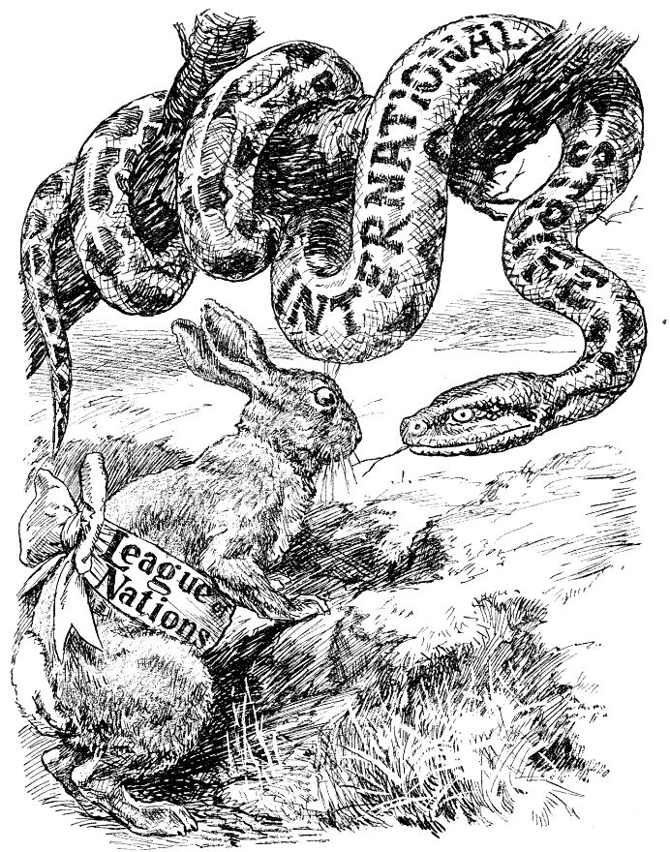
Why didn’t the League of Nations work?
The League of Nations (supposedly the crowning achievement of the Treaty of Versailles) proved to be ineffectual in its goal of world peace.
Its plan was weak and unstructured and the body was not given the necessary components to be effective.
The United States chose not join, while Germany and Russia were not allowed to join (Germany was allowed in 1926, but then withdrew in 1933 and the Soviet Union didn’t officially join until 1934). Japan and Italy, who were charter members, withdrew (in 1933 and 1937).
Without the major powers present, the League had no authority or influence in these nations.

Slide 17
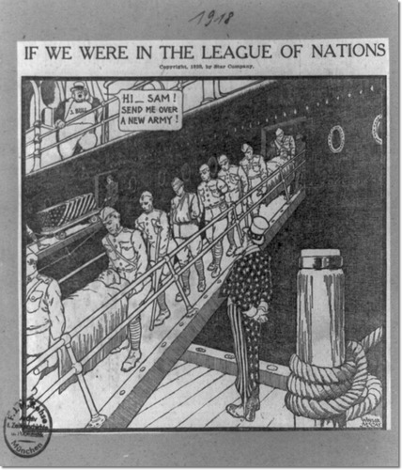
What other weaknesses existed in the League of Nations?
Another weakness was that the League had no power to enforce its directives beyond moral persuasion. In theory the League could wage war, but it would have to use volunteer troops from member nations.
The third weakness of the League was that it required unanimous consent for decisions, which was almost impossible to get.

Slide 18
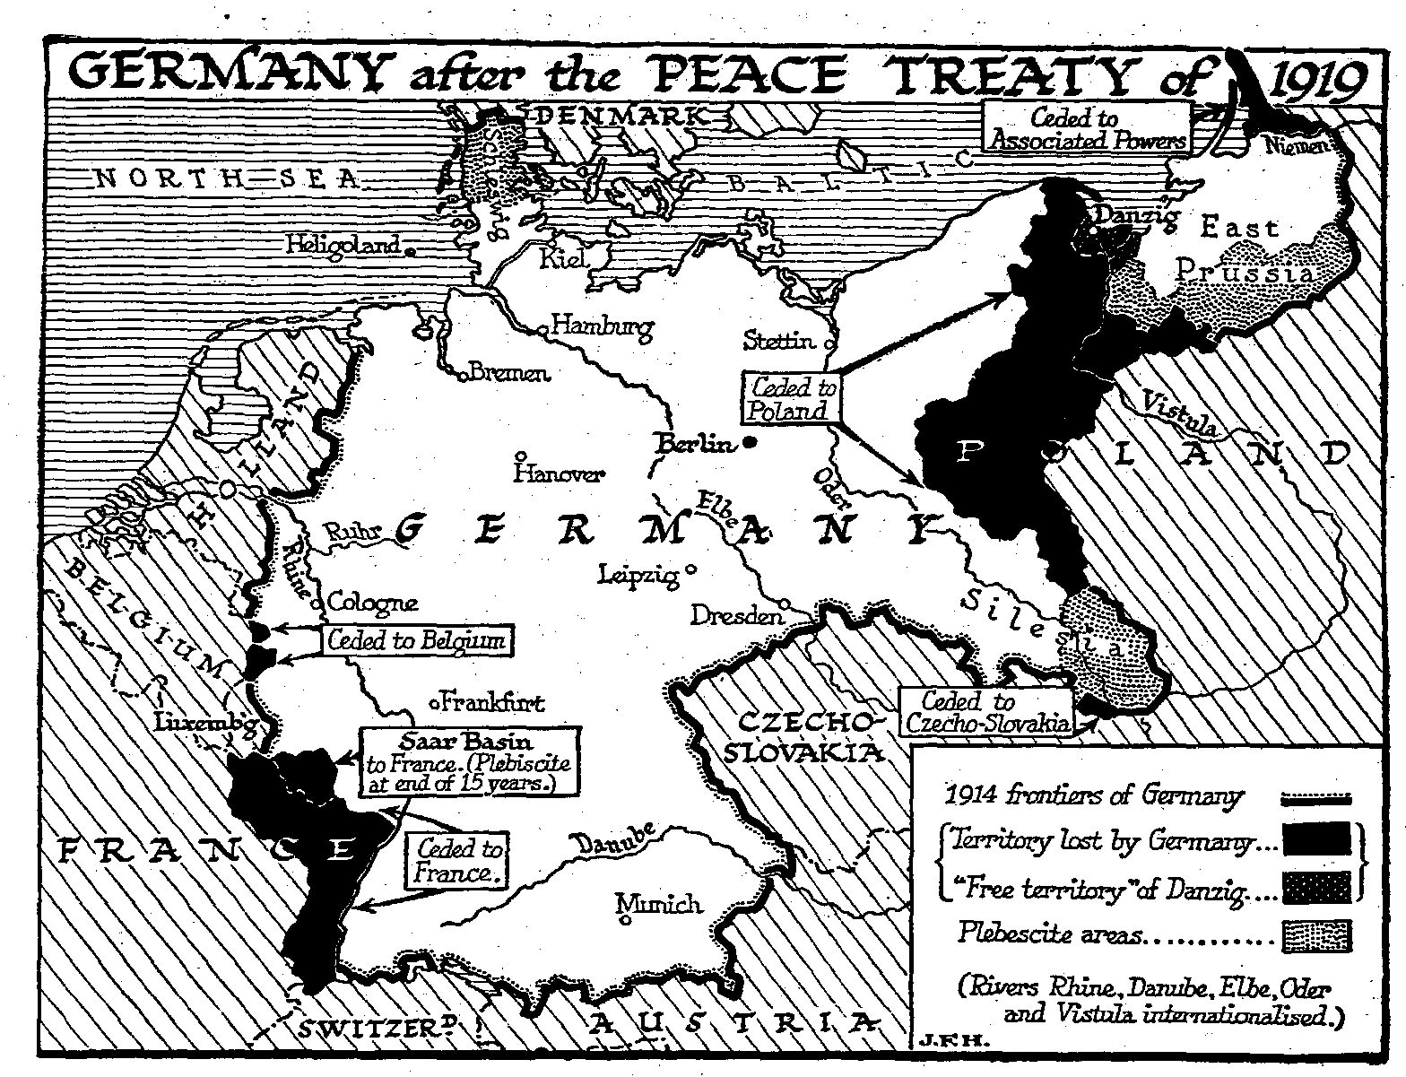
You decide...
Political boundaries still remained an issue. Wilson had tried to propose self-determination in forming international borders. The principle was only used selectively and usually to benefit the Allied Powers.

Slide 19
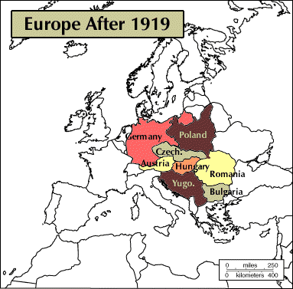
you decide again...
Boundaries changed even more when the Austro-Hungarian and Ottoman Empires were broken up.
Poland was created and both Germany and Russia lost territory due to the Treaty of Brest-Litovsk (separate treaty between Germany and Russia in 1917).
The Soviets did gain some of this territory back.

